Slide 1
Recursion

Slide 2
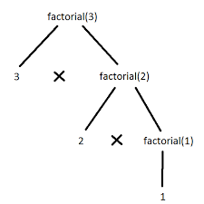
Factorial 3 using recursion return (num * factorial(num-1))

Slide 3
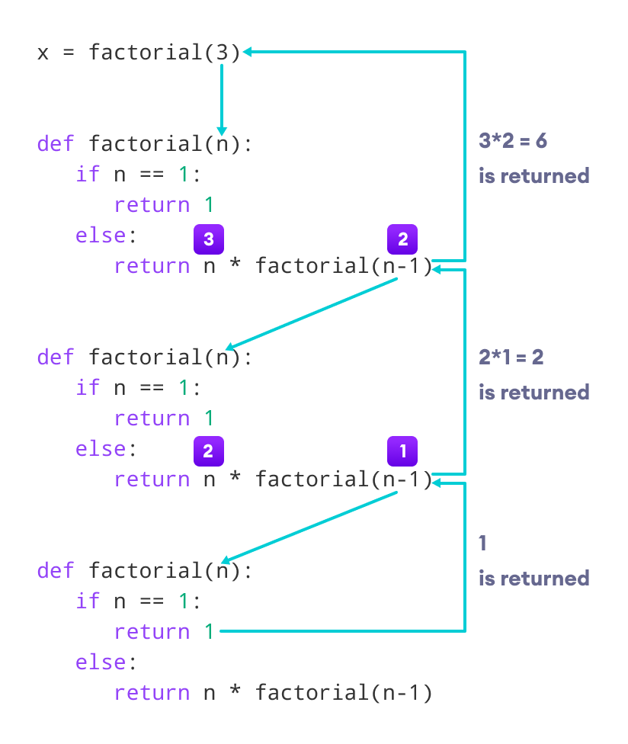

Slide 4
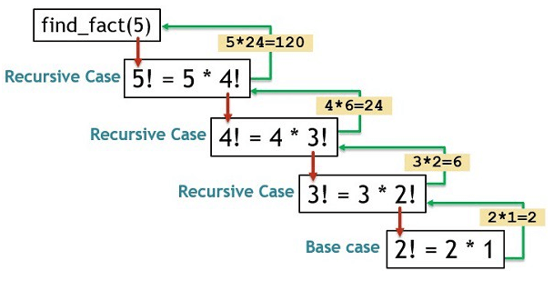
Factorial 5

Slide 5
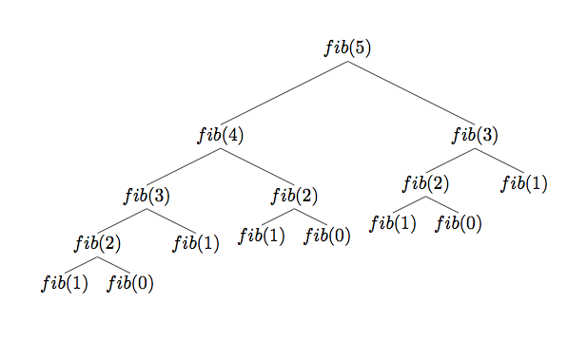
Fibonacci
€
+
+
+
+
+
+
+

